Slide 1
Module 2

Slide 2
Getting Started with AVATAR
Vertical Alignment Teams (VATs)

Slide 3
“Never doubt that a small group of thoughtful,
committed people can change the world.”
Margaret Meade

Slide 4
Over a decade ago, in 2000, the Texas Higher Education Coordinating Board began an initiative to close the gaps of educational attainment among subgroups of students in Texas in the areas of:
Student Participation
Student Success
Student Excellence
Student Research
Source: Closing the Gaps Progress Report, June 2012
Retrieved from: http://www.thecb.state.tx.us/index.cfm?objectid=858D2E7C-F5C8-97E9-0CDEB3037C1C2CA3

Slide 5
Progress since the year 2000

Slide 6
Are we really responsible for getting all students college and career ready?

Slide 7
AVATAR is a Process
Creates and builds relationships through ongoing critical conversations
Uses regional data to make alignment decisions
Develops shared understanding of college and career readiness and success for students
Identifies and implements intentional actions
Evaluates, sustains, and shares vertical alignment work

Slide 8
This Module will introduce…
VAT Purposes
Benefits and Challenges of VAT Membership
Group Logistics
Group Norms
Individual and Group Responsibilities

Slide 9
VAT Purposes

Slide 10
Invitation to
Closing the Gaps
While progress is being made in “Closing the Gaps,” your work to promote academic enrollment, achievement, and success in postsecondary education remains needed, and participation in vertical alignment of core curriculum through AVATAR is one way to do this.

Slide 11
Closing the Gaps Summary
For an up-to-date look at Texas’ progress in closing the educational attainment gaps go to the Texas Higher Education Coordinating Board’s dashboards:
http://reports.thecb.state.tx.us/approot/closingthegaps/hed_main.htm?FIRSTRPT=CTG
Source: Closing the Gaps Progress Report, June 2012
Retrieved from: http://www.thecb.state.tx.us/index.cfm?objectid=858D2E7C-F5C8-97E9-0CDEB3037C1C2CA3

Slide 12
Defining Vertical Alignment
An important way to Close the Gaps is through vertical alignment of the curriculum. Squires defines curriculum as the written plan for use of time, “content, and process aligned to the standards and assessments that focus instruction, assessment, staff development, and management so that students succeed.”
Reference: P. 143. Squires, D. A. (2009). Curriculum Alignment: Research-Based Strategies for Increasing Student Achievement. Thousand Oaks, CA, Corwin,

Slide 13
Benefits and Challenges of VAT Membership

Slide 14
AVATAR Partner & Team Benefits
Regional Partners will
Team Members will
Collaborate across K-12 education, higher education, and with business and the community, as required by HB 5.
Take ownership for college and career readiness of a common group of students.
Build capacity to improve alignment of K-12 and college core curriculum.
Develop relationships with colleagues at other levels of education and in careers related to the discipline.
Apply principles of vertical alignment across K-12 and higher education in your discipline.
Lead professional development of colleagues in the partnership.
Help students make successful college and career transitions.

Slide 15
AVATAR Partner & Team Challenges
Regional Partners must
Team Members must
Maintain a vision of high standards for all students.
Recruit VAT members who are change agents, and attend to their recommendations.
Model collaboration across the partnership and within your own member organization.
Remain active in the VAT even when it is inconvenient.
Apply principles of vertical alignment in your own classroom first. (You will change your practice.)
Listen to other VAT members.
Focus on students and their learning.

Slide 16
Team Member Introductions
Activity:
Go Round Robin and introduce team members
Where, what, and why do you teach?
What experience do you have with collaboration in curriculum development?

Slide 17
Group Logistics

Slide 18
Meeting Logistics
Let the coordinator/facilitator take the lead in establishing times and places for the meetings. AVATAR VATs have met during the school day, after school, and/or on Saturdays. AVATAR VATs have met face to face and/or online. Be prepared for the teaching schedules of higher education members to change in the second semester so that they may no longer be available at a given time.
Establish and follow a set of norms for all meetings.
If refreshments are part of the meetings, and they often are, discuss expectations, allergies, dietary needs.

Slide 19
Meetings— More Logistic
Establish a plan to keep records of the meetings. Use the AVATAR form for record-keeping. Submit notes to be posted on the AVATAR website.
Establish a plan for communication among the VAT. E-mail, Moodle, Dropbox, a blog—all of these have been used successfully for regular communication among VATs. Have a plan. Make sure the every member of the group knows how to use the communication tools you’ve chosen.
Plan how members of the VAT will inform the leaders of the partnership who appointed each of you. A May sharing meeting is required, but regular communication is needed for awareness of your progress and implementation of suggestions.

Slide 20
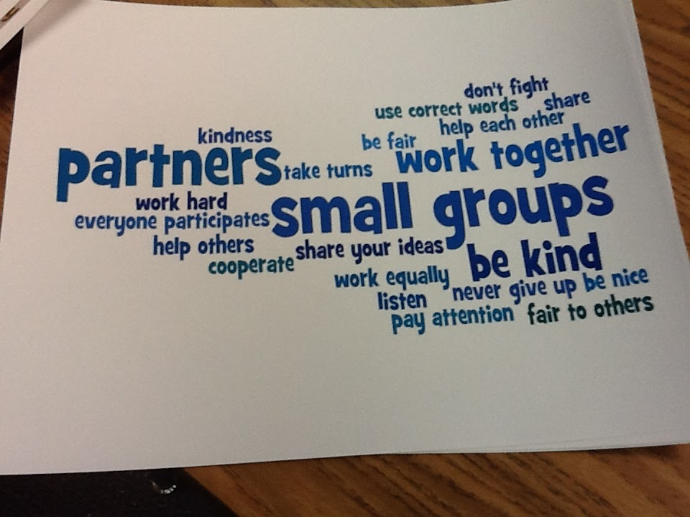
Group Norms

Slide 21
Norms
Norms encourage behaviors that will help a group do its work and discourage behaviors that interfere with a group’s effectiveness.

Slide 22
Norms across Cultures
VATs cross the cultures of K-12 and higher education, which differ in their valuing of deliberation vs. efficiency and collaboration vs. individual achievement. Norms, along with good will, can help you work across cultures.

Slide 23
Functions of Norms
Standards or expectations by which individuals in a group have agreed to operate while working together
Maximize team productivity and effectiveness
Ensure individuals are respected
Place responsibility on individuals for expected behavior to build group community

Slide 24
Some Sample Norms
Begin and end the meeting on time.
Notify the leader if you must be late or absent.
Come prepared with assignments completed.
Assure that everyone has a change to speak without being interrupted. Set time limits if this is helpful.
As each meeting ends, plan for sharing with partnership leaders at your institution (Department chair, dean, provost, principal, counselor, as appropriate).

Slide 25
Individual and Group Responsibilities

Slide 26
What Is My Role as an AVATAR Partner or Team Member?
What knowledge can you contribute?
What skills can you bring to the group?

Slide 27
VATS draw on multiple knowledge bases. Which of these do you know well?
Knowledge of content and pedagogy in your discipline
Pedagogical content knowledge
Knowledge of resources and technology in your discipline
Knowledge of high school learners
Knowledge of college learners
Knowledge of instruction
Knowledge of state standards, the TEKS and/or the CCRS
Knowledge of state assessments, STAAR/EOC and/or the TSI
Knowledge of the state curriculum
Knowledge of college readiness
Knowledge of vertical alignment processes

Slide 28
VATS draw on varied skills of members. Which are your strengths?
Facilitator
Deliberator
Inquirer
Summarizer
Connector
Organizer
Visualizer
Critic
Encourager
Do you focus on the big picture?
Do you see the relevance of details?
Do you have a good imagination?
Are you committed to social justice?
Can you imagine a future where all students teach their educational potentials?

Slide 29
Next Steps
Put the VAT meeting times on your calendar.
Determine any assignments before the next online or face to face meeting.
Do you need any more team members to make this process more successful?
Do you need partners who may be part of your feeder pattern but are missing from the table?

Slide 30
Items Your Group May Want to Think About:
Begin with the end in mind (What do you want to achieve at each meeting?)
Be respectful when others are voicing an opinion
Participate actively
Ask questions
Share experiences and insights
Make connections
Help each other
Tame the technology (Limit cell phone use, refrain from answering e-mails and surfing the web on laptops, iPad's, etc.)

Slide 31
Recap
Purpose,
Benefits and Challenges of VAT Membership
Group Logistic
Group Norms
Individual and Group Responsibilities

Slide 32
Questions

