Slide 1
Academic Vertical Alignment Training and Renewal (AVATAR) Project
Fall 2011 Pilot Project
Region 10 Module Four B
College and Career Readiness Standards

Slide 2
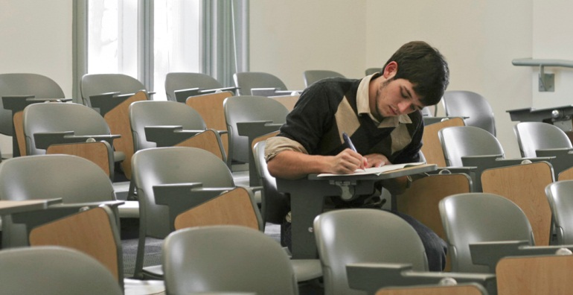
College and Career Readiness Standards (CCRS)
Developed collaboratively with the Texas Higher Education Coordinating Board (THECB)
Established what students must know and be able to do to succeed in entry-level college courses

Slide 3
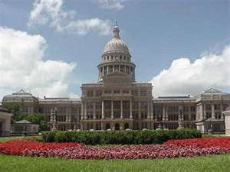
COLLEGE READINESS
House Bill 3 defines college readiness as the level of preparation a student must attain in English language arts and mathematics courses to enroll and succeed, without remediation, in an entry-level general education course for credit in that same content area for a baccalaureate degree or associate degree program.
(Section 39.024a)

Slide 4
High School Graduation and College and Career Readiness Standards (CCRS)
TEKS course standards focus on high school graduation
Course content knowledge is aligned to the Texas Assessment Program (TAKS/STAAR End-of-Course)
CCRS focus on credit bearing, entry-level general education coursework

Slide 5
Structure of the CCRS
Hierarchal Structure
Represents the structure of the discipline and subject areas within the discipline
Emphasizing that college readiness is about understanding the organizing concepts of the subject area along with specific skills
Three Levels Plus Examples
Key Content organizing structure of the subject area
Organizing Components conceptual topics
Performance Expectations general goals
Performance indicators example student performances
Not part of CCRS but included as possible examples of students performance; not a definitive list of all possible performances

Slide 6
CCRS Organization
Notes:
Page v

Slide 7
CCRS Organization
Key Content: Keystone ideas of a discipline that reverberate as themes throughout the curriculum. (Designated by Roman numerals.)
Organizing Components: Knowledge and subject areas that organize a discipline around what students should retain, be able to transfer, and apply to new knowledge and skills. (Designated by capital letters.)
Performance Expectations: Knowledge and skills that represent important ideas of the current understanding of each organizing concept as well as the multiple contexts to which each organizing concept can be manifest. (Designated by numbers)

Slide 8
CCRS Organization
Examples of Performance Indicators: Examples of how to assess and measure performance expectations. This list of indictors is not meant to be either exhaustive or prescriptive. The operating premise is that the more of these or other similar indicators a student is successfully able to demonstrate, the greater the probability that the student will be prepared to succeed in college. (Designated by lowercase letters and shading in the appendix of this document.)

Slide 9
Reviewing the Texas CCRS
Turn to page 8 (or page 14) of the Texas College and Career Readiness Standards, review the following for the Mathematics (Science) Standards:
The introductory section
The explanatory section
The overall structure
Select one Organizing Component (concept) that you think is important to college readiness
Why do you think it is important.
What are the effects of students not being ready in this area?
Brainstorm what could be done to improve readiness in this area.
Notes:
Pages 2-5

Slide 10
CROSSWALK Between TEKS, EOC, and CCRS
Participants will
Highlight the CCRS standards in the TEKS.
Discuss the standards or structures that are similar and different from the TEKS.

Slide 11
Cross-Disciplinary Standards
Skills that are important across one or more disciplines
Critical to postsecondary success
Should not be taught in isolation
Divided into two key content areas
Key Cognitive Skills
Foundational Skills
Notes:
Pages 30-31

Slide 12
Cross-Disciplinary Standards
Examine the CCRS Cross-Disciplinary Standards.
Consider ways the CCRS Cross-Disciplinary standards can be taught and assessed.

Slide 13
Texas College and Career Readiness Standards Uses
Help high schools set the challenge level and content necessary for college and career readiness
Use as a reference point to design aligned high school and college courses
Create a more rigorous senior year
Prepare students for workforce skills and expectations
Help higher education increase course consistency
Develop better college placement criteria

Slide 14
Texas Initiatives CCRS Support
Closing the Gaps
Adopted in October 2000 by the THECB with strong support of the state’s educational, business, and political communities
Directed at closing educational gaps within Texas, as well as between Texas and other states
Closing the gaps in
student participation
student success
excellence
research
Reduces need for student remediation

Slide 15
Texas Initiatives CCRS Support
End of Course Exams (Senate Bill 1031)
STAAR will be implemented in 2011-2012 in core subject areas
Students will be required to pass EOCs in order to graduate
EOCs reflect increased rigor and a wider range of content

Slide 16
TEA Response to HB1
HB 1 mandates that the CCRS online student materials be made available:
Materials will focus on students needing extra support
Materials will be linked to the THECB senior assignments
Materials will be ready:
Fall 2010 for Mathematics
Fall 2011 for Science

Slide 17
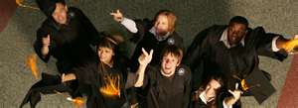
“Generally, the more standards a student can demonstrate successfully, the more likely it is that he or she will be college and career ready.”

